Slide 1
Orekit vs STK

Slide 2
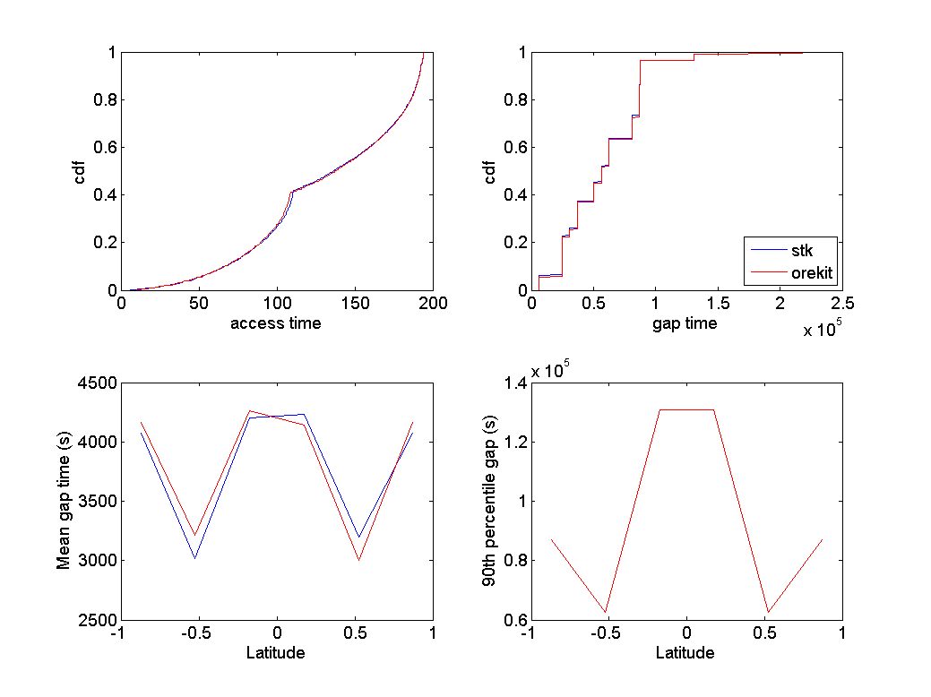
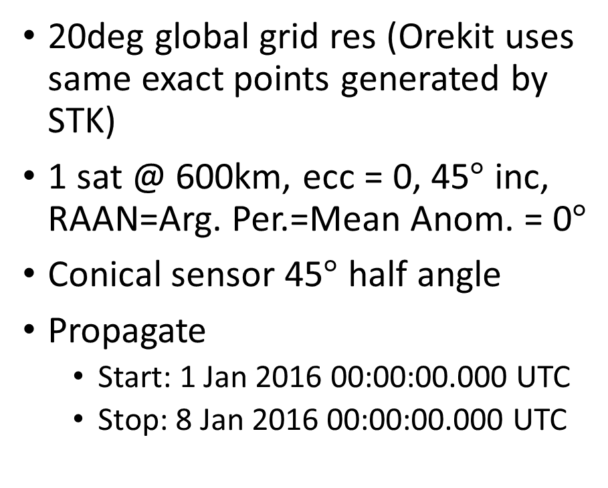
Keplerian with simple conical sensor
20deg global grid res (Orekit uses same exact points generated by STK)
1 sat @ 600km, ecc = 0, 45$°$ inc, RAAN=Arg. Per.=Mean Anom. = 0$°$
Conical sensor 45$°$ half angle
Propagate
  Start: 1 Jan 2016 00:00:00.000 UTC
  Stop: 8 Jan 2016 00:00:00.000 UTC

Slide 3
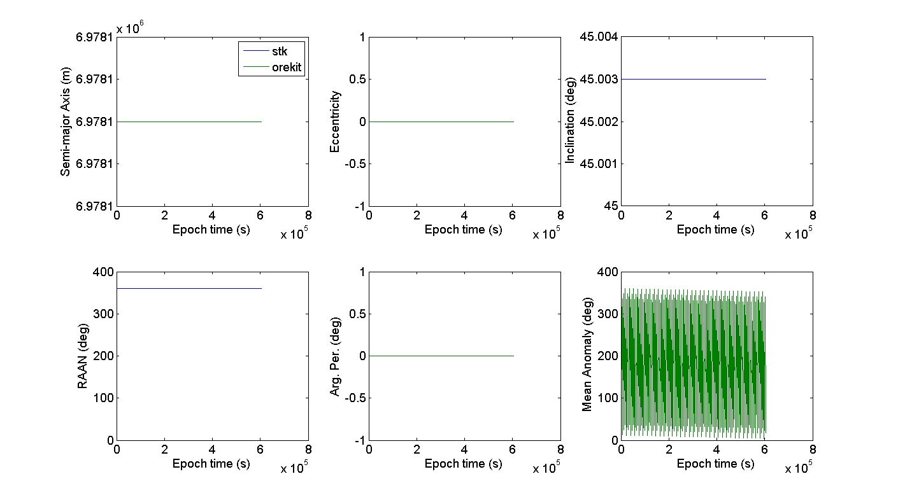
Keplerian with simple conical sensor
Orbital Parameters are a near perfect match

Slide 4
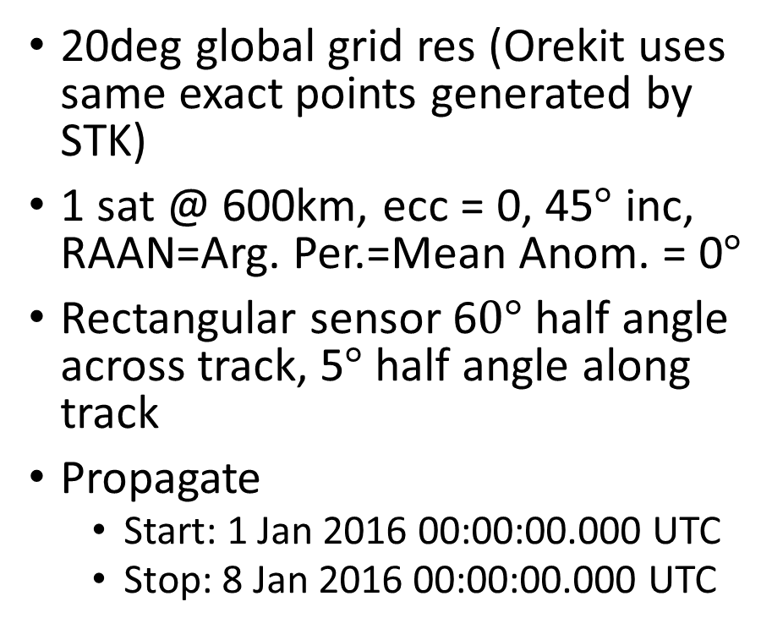
Keplerian with rectangular sensor
20deg global grid res (Orekit uses same exact points generated by STK)
1 sat @ 600km, ecc = 0, 45$°$ inc, RAAN=Arg. Per.=Mean Anom. = 0$°$
Rectangular sensor 6$0°$ half angle across track, 5$°$ half angle along track
Propagate
  Start: 1 Jan 2016 00:00:00.000 UTC
  Stop: 8 Jan 2016 00:00:00.000 UTC

Slide 5
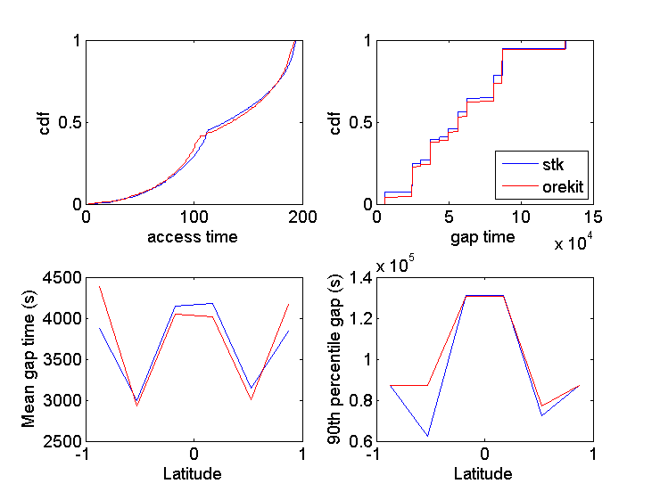
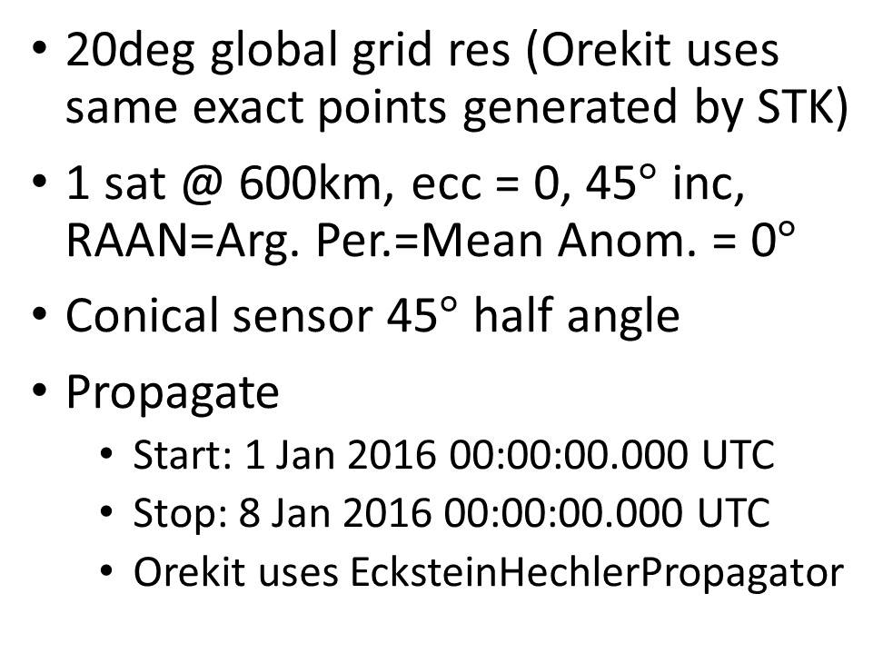
J2 with simple conical sensor
20deg global grid res (Orekit uses same exact points generated by STK)
1 sat @ 600km, ecc = 0, 45$°$ inc, RAAN=Arg. Per.=Mean Anom. = 0$°$
Conical sensor 45$°$ half angle
Propagate
  Start: 1 Jan 2016 00:00:00.000 UTC
  Stop: 8 Jan 2016 00:00:00.000 UTC
  Orekit uses EcksteinHechlerPropagator

Slide 6
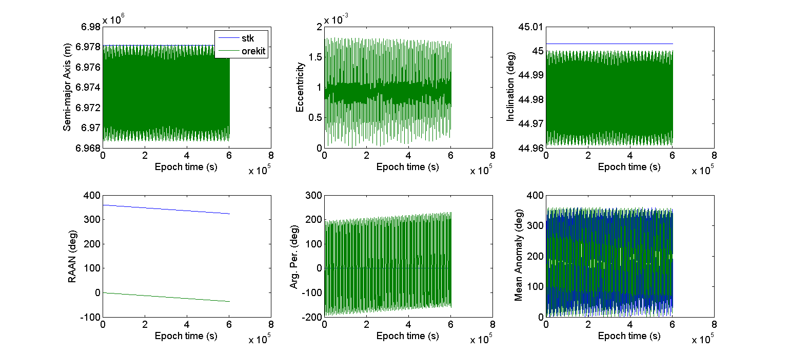
J2 with simple conical sensor
Orekit has noise in some parameters

